Slide 1
Sourcing: Auctions
July, 2013

Slide 2
Agenda
In this presentation and hands-on we will:
  Discuss the types and purpose of Auctions
  Cover the steps in creating and running, with a focus on Reverse English auctions
  We also discuss relevant Best Practices

Slide 3
Auctions Overview
Like RFQ's and RFP's, Auctions are ways for buyers to provide a list of goods or services they need to source, and allow potential suppliers to submit bids for them. The goal is usually to achieve the lowest possible price for the item, so all of these RFx options have the same goal, just different mechanisms to get bids.
Most common is Reverse Auction, which has two supported types (officially “Styles”):
    English – The items are open for bid and suppliers compete by reducing their bids for each selected item. The suppliers lower their price with each successive bid. The item is awarded to the supplier with the lowest bid.
    Dutch – the items are open for bid with a “low” price visible to the Suppliers and the system increases the price (by an amount the Buyer sets) until a Supplier accepts the price and “bids” to supply the item at the displayed price.
    Japanese – (You may see references to this in old Emptoris material, but it is not supported. Mentioned here FYI …) Items open at a given price and all bidders must bid for the item. As the price is reduced, bidders must drop out or bid at each level to remain in the running for the item. The auction continues until only one bidder remains.

Slide 4
Auctions Overview, cont.
    Forward Auction – A forward auction is a fairly rare event where a buyer can sell items back to suppliers. Here, Starting Price refers to the lowest price and the suppliers have to bid the price up. The goal is for the buyer to achieve the highest price for the item. Forward auctions can be English or Dutch, but the bidding goes in the other direction from a Reverse Auction.
Auctions are quite popular with some customers (buyers) because no analysis of bids is required (as for RFx's), and they are generally faster and take less effort to run than RFx's. They are also a very effective way to bring savings, but in doing so they can strain relationships with suppliers.
Depending on how it is configured, an Auction can be a frenzy of activity, with multiple items being bid on currently by many suppliers, and with suppliers seeing the others' bids. Or it can be relatively sedate, with bidding focused on one item at a time, and with no visibility into others' bids. (The latter is more like an RFQ or RFP, or the extreme case of a “sealed bid” scenario where there is no awareness of bid amounts until the event closes.)

Slide 5
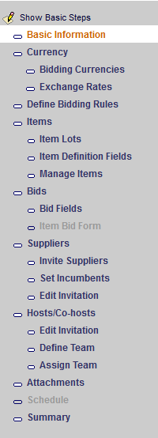
Creating an Auction
As for an RFI/RFQ/RFP, creating an Auction can be done from scratch, from a template, or from an import. In addition, an Auction (Reverse only) can be created from an existing but unawarded RFQ or RFP, although the questionnaires from an RFP do not apply to an Auction.
If you create from an RFQ or RFP, its definition (Items, Suppliers, Bid Fields, etc.) is transferred to the Auction. That includes the suppliers' lowest bids, which become their opening bids for the Auction. You can invite additional suppliers who weren't in the RFx.
The full set of Wizard steps to define an Auction is shown at the right. The steps are almost identical to the steps for an RFQ.

Slide 6
Creating an Auction, cont.
Definition differences between Auction and RFQ:
    Item Lots: Auction has the concept of a Forced Lot, which requires suppliers to bid on all Items in the Lot (or none). Also, for a Lot you can allow bidirectional bids at the item level, meaning that bids on some items can be increased, as long as decreases are made on others such that the total bid for the Lot decreases.
    Set Incumbents: This lets you link Items in the Auction to their incumbent suppliers, which later allows you to focus on their bids during the auction.
    Set Preliminary Bids: This step can appear in the Wizard below Set Incumbents, after Items have been added and Suppliers invited. If the auction was created from an RFQ or RFP and bids rolled over from it, the buyer can use this step to modify the bids (which the supplier can later accept or reject). Or the buyer can simply add new bids on behalf of the supplier.

Slide 7
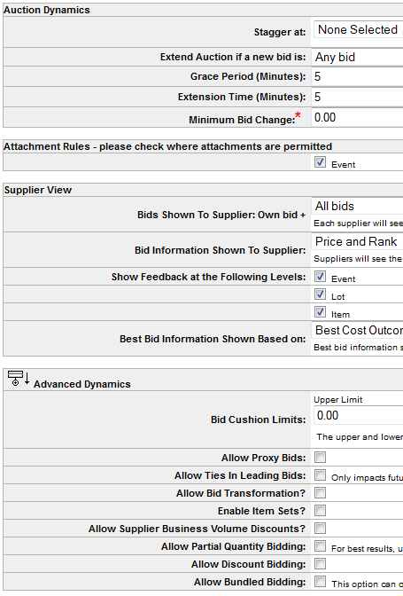
Reverse English Auction Bidding Rules
Starting here, much of this content applies to Reverse English and NOT Reverse Dutch auctions. The differences are discussed later.
Bidding rules control many aspects of how suppliers can respond to an Auction.
Auction rules have some overlap with RFQ/RFP rules, but there are many more options and greater complexity, reflecting the real-time nature of auctions.
The rules are presented in three groups:
    Auction Dynamics
    Supplier View
    Advanced Dynamics

Slide 8
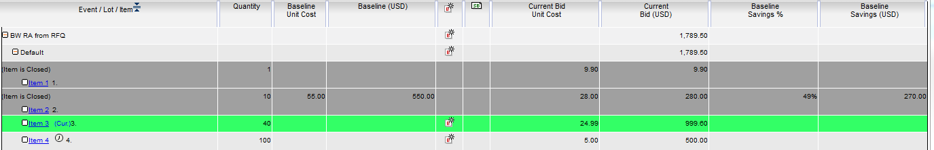
Auction Bidding Rules, cont.
Auction Dynamics:
    Stagger: By default, bidding on all Items (or lots) ends at same time, which can be hard for suppliers to manage. Instead, close of bidding on Items or Lots can be staggered by a specified number of minutes. (All Items/Lots open at once.)
    In the example below, there are four items being bid on. Bidding on the first two has closed, and the third is “current” (next to close). Bids can be submitted on the third and fourth items at this moment.
    Grace Period (G) and Extension Time (E): If a new bid, leading bid, top two bid, or other (as specified by the “Extend Auction if a new bid is” value) comes in within G minutes of the bid close, the bidding is extended from that point by E minutes. This is to prevent deliberate last-second winning bids.
    Supplier View
    Advanced Dynamics

Slide 9
Auction Bidding Rules, cont.
Auction Dynamics, cont.:
    Minimum Bid Change (M): This value M can be an amount or a percentage. If the Supplier uses the “Take the Lead” option for his bid, Sourcing generates a new bid lower than the current leader by M. If the Supplier clicks the “Minimum Change” button, his current bid will be reduced by M.
Supplier View:
    Bids Shown to Supplier: During auction bidding, suppliers always see their own bids. This value determines what other bids they see: None, All, the Leading Bid, the next Lowest Bid, the next Lowest Bid and the Leading Bid.
    Bid Information Shown to Supplier: For the bids shown according to the previous option, this one determine what gets displayed for each. There are many options here, with such choices as the price, rank, both of those, etc.
    Show Feedback at the Following Levels: Event, Lot, or Item
    Best Bid Information Shown Based on: Best Cost Outcome or Single Source (very similar to the Scenarios for an RFQ or RFP)
    Supplier View
    Advanced Dynamics

Slide 10
Auction Bidding Rules, cont.
Advanced Dynamics:
    Bid Cushion Limits: Protects the leading bidder by requiring a new bid to fall with in the cushion limits. E.g., don't allow $99.99 to beat $100.00.
    Allow Proxy Bids: Allows the supplier to define the parameters to automatically generate a new bid (based on the Minimum Bid Change configuration) when triggered by a lower bid by another supplier.
    Allow Ties in Leading Bids: If ties are allowed, the first submitted would be ranked higher, but buyer would decide which to award. It makes particular sense to allow ties when the buyer wants to purchase from multiple suppliers.
    Allow Bid Transformation: Enabling this lets the buyer adjust bids with a multiplier for different bidders, without them seeing this. For example, build in a preference for incumbent bids, or deal with different currencies. More later.
    Allow Partial Quantity Bidding: Let suppliers bid on fewer than the Minimum Desired Quantity.
    The other options are straightforward or the same as in RFQ, except that Substitution Sets are not supported.
    Supplier View
    Advanced Dynamics

Slide 11
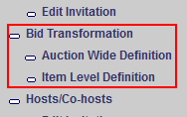
Bid Transformation
If Allow Bid Transformation is chosen, new steps appear in the Wizard (might need to jump to Monitor and back to Edit to see them). These allow the buyer to adjust suppliers' bids at the auction or item levels.
Multiplier (M) and adder (A) can be specified per supplier.
Original bid (B) is transformed in buyer's view to B' = (B * M) + A
If bids are visible to other suppliers, each other supplier's bid is adjusted for supplier S to view by applying the other supplier's multiplier and then dividing by S's multiplier. Effect is to have net bids reflect same ranking that buyer has.
Transformations can also be made at Item level within each supplier; these override any at the Auction level.
Transformational bidding only applies to Items not using discount bidding.

Slide 12

Scheduling the Auction
Scheduling is the same as for an RFQ or RFP, with a few differences:
    Since an Auction is in real time, you don't usually have the luxury of taking a big break to close the auction and start a new round after bids are corrected. Instead, you can Pause the action using the button shown below, remove bad bids, and later resume it.
    As discussed earlier, the Stagger option can be used so that not all items (or lots) are bid on with the same close time. Bidding on all items/lots opens at the same time.
    A Message button is provided to make communication between suppliers and buyers easy (after scheduling). Awareness of incoming messages is provided by the Message button flashing orange, and they can be read by clicking that button.

Slide 13
Suppliers' Responses to Auction
Suppliers respond to an Auction in a very similar manner as to an RFQ/RFP.
As usual before accepting an event invitation, each supplier should review the description of the auction, any attachments, and at least some of the Items up for bidding. Something unique to Auctions is the “View Bidding Rules” link; suppliers should go here to see the rules, which can be much more complex than for other event types.
When accepting an invitation, suppliers are asked to accept or reject any Preliminary Bids that might have been transferred from the originating RFQ/RFP or entered by the buyer.
There is a great deal of flexibility in how bids can be entered: individual items vs. Lots, partial quantities, discounts, proxy bids, etc., depending on how the host configured the event.
Unlike in an RFQ/RFP, suppliers are generally aware of the other bids. Their focus is on giving bids lower than the current ones, subject to the Minimum Change amount.

Slide 14
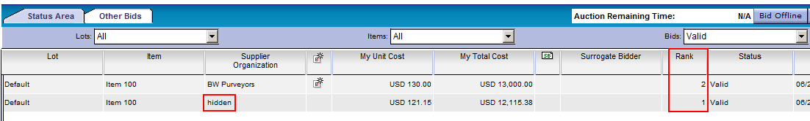
Suppliers' Responses to Auction, cont.
Only after the supplier submits a bid will he/she see information such as whether that is the best bid (depending on the event configuration).
On the Status Area tab in the example below, the logged in supplier, from BW Purveyors, can see that his bid is ranked second behind some unknown competitor's. In this case, Bid Transformation was in use, which adjusted the competitor's bid from its original USD 120 per unit.
The Other Bids tab can be used to see additional information about the bids, but bidding can only be done on the Status Area tab.
If the buyer created the auction with a non-zero Minimum Bid Change value, non-leading bidders will see the Take Lead (also requires “Bids Shown To Supplier” = All) and Minimum Change actions, which can be used to generate a new leading bid or reduce current bid. If a Bid Cushion is in effect, Minimum Change may not result in a valid bid, so they would need to bid again.

Slide 15
Suppliers' Responses to Auction, cont.
If Proxy Bidding is supported, the supplier can enter a “floor” for bids on an item. If so, other bids will cause this supplier's bid to be reduced until he wins the bid or the floor is reached.
If a Lot has a Bid button, but the individual Items in it don't, that means it's a Forced Lot. The supplier must bid on all items in the Lot level or none of them, and no partial bids are accepted. Bids can be adjusted up and down within the Lot, as long as the total is under the value indicated by clicking the Requirements icon in the Actions column.
If staggered bidding is in use, the supplier can bid on any of the items (or lots) that have not yet closed, but should focus on the one highlighted in green, which is the next to close.

Slide 16
(Buyers) Monitoring Auctions
The Monitor tab takes the buyer into the Bid Monitor Console for the auction, which is a powerful and potentially overwhelming display of what's going on in real time.
The monitor has three main parts:
    Participants Frame: shows the suppliers and their status (e.g., logged in but no bids in the last 10 minutes)
    Saving/Bid Summary: presents the sum of current bids and projects savings relative to the Historical Costs
    Auction Action Frame: the main source of information, with tabs for various views of the bids including rankings by supplier and bid history.
If a supplier makes a mistake, the buyer can Pause the auction and remove bad bids, then resume.
The Message button lets the buyer send pre-defined or ad hoc messages to everyone, the internal team or members, or all or individual bidders.

Slide 17
(Buyers) Monitoring Auctions, cont.
A number of special actions can be taken by the buyer:
    In the Participants Frame:
        Revoke a supplier's invitation
        Place a Surrogate Bid on behalf of a supplier who can't access the system for some reason
    On the Bid History page:
        You can invalidate a bid, but must first Pause the auction. Because bids after the invalid one may have been affected, the fair course of action is to delete all subsequent bids, and an option is provided to do that. After the invalidation is done, Resume the auction.
    In the Status Area: You can Extend the event, as well as Pause and Resume.
    On the Edit tab, Schedule step: You can close the auction immediately or change the closing time to be earlier than was scheduled.

Slide 18
Analyzing and Awarding an Auction
The analysis of an auction is fundamentally the same as for an RFQ/RFP: once the auction is closed, the default scenario, LowestCostOutcome, is run automatically, and you can also run the other supplied scenario, SingleSource, and create your own.
Several reports can be run for the auction. The Basic Bid Report, Advanced Bid Report, Scenario Comparison Report, and Supplier Participation Report are very similar to the equivalent RFQ/RFP reports. In addition there are these for auctions:
    Bid History: a very simple list of all bids, with one line of detail per bid
    Auction Savings Report: provides tabular and graphical views of the bids and the savings relative to the Historical Costs.
The process of Awarding a Reverse English auction is the same as for an RFQ/RFP: the buyer has the same bid information (but obtained in a different way) and the same scenarios, and awards the action based on the chosen scenario.

Slide 19
Best Practices for Auctions
A key design consideration for auctions is to not make them too long. Because auctions are in real time, there is not much opportunity for breaks.
Auction duration should normally be planned for 30-60 minutes, with 3-minute Grace and Extension periods.
Suggested maximum number of items per auction is about 100. Use multiple auctions if there are more than that.
With these guidelines, an auction could run for up to about two hours, which is about the longest time both buyers and suppliers can be expected to fully concentrate.

Slide 20
Demonstration and Ad Hoc Exercise: Initial Creation of Auction
Login to SSM using your assigned Buyer Application Manager (BAM) user
Create a Reverse English Auction; name it beginning with your initials; Save
On the Define Bidding Rules window, examine the options. Leave all of the defaults, except for:
    Stagger at Item Level, with Incremental Closing Time = 5 minutes
    Minimum Bid Change = 5.00 (an Amount)
    Allow Proxy Bids (check the box)
    Save
Create a Simple Item. Use Minimum Desired Quantity = 100, Historical Cost = $55, Start Price = $50,. For Category, enter “fi” in the search area and pick one of the returned category names (or do a full search). Click “Save and Add Next”.
Create one more Simple Item with the same values as above. Notice that the Category defaults to the previous one selected (which is OK here).

Slide 21
Demonstration and Ad Hoc Exercise: Creation, Running of Auction (cont.)
Invite three of your assigned suppliers to the Reverse Auction as a whole (as opposed to specific Items or Categories).
In the navigation area, click Set Incumbents (only visible when Show All Steps is in effect). Click the folder icon for the first item, then click “Link Incumbent Supplier to Item”, choose the first supplier (check the box), click Link Selected Supplier, and confirm the link. Repeat for the second item and second supplier.
Schedule the event to open immediately and close in one hour. Keep the session open and visible; click on the Monitor tab, to see bids coming in.
We will now use different suppliers to simulate a simple auction.
Log in (in a different browser (IE/Firefox, not just a new tab)) as the first invited Supplier. Click View/Respond for the auction, then Accept it. Submit a bid with Price Per Unit of $50 for the first item. Enter a bid of $60 for the second item and see what happens; change to $50 and submit, then log out. Back in the Buyer session, observe the bids (Monitor tab). Keep in mind that the bids will be going lower, for the buyer to receive the best possible price.

Slide 22
Demonstration and Ad Hoc Exercise: Creation, Running of Auction (cont.)
Log in as the second invited supplier. View/Respond and Accept the auction. This supplier will use proxy bidding. For the first item, click Define Proxy Rules. Under Proxy Setup, enter a Price Per Unit value of 25, to be the floor price for proxy bidding, click Yes (beside the proxy PPU field), then click the icon for “Save Proxy Setup” (hover over it to see that name). In the regular bid field, enter 45 and submit. Repeat for the other item. Log out. Observe in the Buyer window that the new bids were received and should be the leaders (the lowest).
    Note that the “Take Lead” and “Minimum Bid Change” buttons were not visible, because the supplier has not yet made a bid.
Log in as the first invited supplier again. View/Respond the auction. For the first item, click the green flag icon for “Take Lead”, which should generate a bid of $40 (lower by $5 (= Minimum Bid Change) than the current leading bid ($45). Submit that bid, and quickly look back at the Buyer window. This new bid should become the new leader, but only very briefly, before the second supplier's proxy bid takes effect (for $35). That proxy bid should be flagged as such in the “Proxy Bidding Enabled” column. Look at the Bid History tab and All bids.

Slide 23
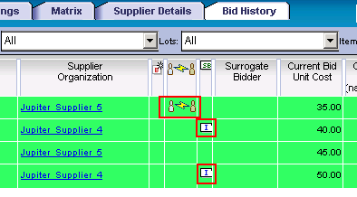
Demonstration and Ad Hoc Exercise: Running of Auction (cont.)
Try sending a message from a supplier to the buyer (host) and observe how it appears in the buyer's session. Optionally reply back to the supplier.
On the buyer's screen, go to the Bid History tab and choose All bids. Look for the proxy bid (flagged in red box on the left in the following screenshot) and incumbent bids (smaller red boxes).
Optionally continue to make new bids from the suppliers, and either explicitly close the auction (Edit tab, Schedule step) or let it close automatically.

Slide 24
Forward Auction
    Fairly rare event, allowing buyers to sell excess inventory back to suppliers. The Starting Price is low, and rises with the bids. All Forward Auctions are of the English style (no Dutch).
    A Forward Auction is created and managed in the same way as a Reverse English Auction: Bidding Rules, Items, Item Fields, Bid Fields, invitations, etc.
    The buyer needs to make it obvious when inviting suppliers that they will be buying items, and bidding in the opposite direction from normal. Otherwise they could be quite confused.
    As for a Reverse auction, you can set the Incumbent Supplier for each item. In this case it normally refers to a supplier who previously bought back the item in a forward auction, not the supplier who originally sold it to the buyer.
    Forward auctions do not have Optimization Scenarios, and hence awarding can only be done manually.
    All other aspects of the Forward Auction are the same as in a Reverse Auction, but switched when it comes to the direction of bids.

Slide 25
Reverse Dutch Auction
Dutch auctions are also fairly rare. As in a Forward auction, item prices start low and rise, but here the price increases are automatic and as designed by the event creator. Also, a Dutch auction has the much more usual action of buyers doing the buying.
    Bidding on an item ends when one or more bids have been submitted such that the Minimum Desired Quantity for the item has been achieved, or the Reserved Price (which in this case is a price ceiling) is exceeded (*).
    The entire auction ends when either the buyer explicitly closes it (perhaps due to difficulties or a need to change auction properties), or bidding on all items is complete. Closing cannot be scheduled in advance.
    Unlike a Reverse English auction, a Reverse Dutch auction cannot be created from a previous RFQ or RFP. The other creation methods (from scratch, from a template, or from an import) all apply.
    (*) The Monitor tab for the buyer always seems to show that bids are allowed at the Reserved Price, while the supplier view sometimes allows bidding at the Reserved Price and other times cuts it off just before that price is reached.

Slide 26
Reverse Dutch Auction, cont.
Defining a Dutch auction has all of the same steps as a Reverse English Auction, but with differences we'll now cover.
Bidding Rules for a Dutch auction are much more limited than for an English auction:
    Auction Dynamics:
        Interval between Price Change: The number of minutes that the bidding stays at the current amount before increasing.
        Price Change: The amount or percentage by which the price increases after the interval expires. This is overridden if a value is given at the Item level.
        Buffer before Bidding Starts: After the auction opens, it sits for this number of minutes before starting the countdown to the next bid increase. This allows the suppliers to settle in; the auction status at this time is Preview.
    Advanced Dynamics:
        Enable Bid Transformation: same as for other auctions
        Allow Partial Quantity Bidding: same as for other auctions

Slide 27
Reverse Dutch Auction, cont.
Items are defined as usual, but they can be given a Price Change amount or %.
It is not possible to add any Bid Fields; Price Per Unit is the only one, and many of its attributes cannot be changed.
Inviting Suppliers is the same as for other auctions, and can be from an RFI. You would want them to be clear that this is not a “normal” (Reverse English) auction.
Once the supplier has accepted the invitation, the auction opens for him/her with two frames:
    Bidding Area: This contains information on the item currently being bid on, as well as a countdown until the next price increase. Note that there is no entry field for a bid amount: the supplier must bid the current amount or not bid at all.
    Status Area: This lists all of the items in the auction, their starting prices and the price change amount or percentage. Only one item is active for bidding at a time; the others are listed as Closed or Pending.
  .

Slide 28
Reverse Dutch Auction, cont.
If a bid is submitted for less than the Minimum Desired Quantity (only valid if Partial Quantity Bidding was enabled), the bid will be accepted, but bidding will continue for other suppliers to bid on (at higher prices, unless they're quick). If the Reserved Price is reached without the minimum quantity being bid, the item will be closed for bidding.
A supplier can never bid for more than the remaining quantity required.
The buyer monitors the auction on the Monitor tab, which provides a display almost the same as the suppliers' view, but with an additional pane showing the suppliers and their activity. The Chart View is a nice graphical way to see the bids and their timing for each item.
Reports are available that are similar to those for the other types of auctions.
Reverse Dutch auctions do not have Optimization Scenarios, and hence awarding can only be done manually.

Slide 29
Demonstration and Ad Hoc Exercise: Reverse Dutch Auction (Optional)
Here's a minimal scenario for observing how a reverse Dutch auction works. Login as the buyer (BAM user) and create the auction.
For Bidding Rules, use a 1-minute interval, $1 price change, and 3-minute buffer; allow Partial Quantity Bidding.
Create three Simple Items, each with Quantity 100, Starting Price $10, and Reserved Price $13.
Invite two suppliers. Prepare to schedule the auction, but before doing so, log in (in a different browser) as one of the invited suppliers. Now open the auction, go back to the supplier session, and look for the new event. Accept it.
Try to have both buyer and supplier windows visible. After the preview ends, wait a minute to see the price rise, then make a bid for the full quantity of the first item. Then bid for half of the quantity of the next item. Log off that supplier, log in the other one, and bid for the other half of the quantity. For the final item, don't bid; wait for time to expire and the auction to be closed automatically.

Slide 30

Questions?

